Slide 1
AstraZeneca AI Hackathon
Jan 2022
A Machine Learning Approach to Identifying Sections and Titles in Documents.
Team Krushers

Slide 2

Notes:
With copious amount of documents available in electronic formats, there is a dire need for some sort of automation to simplify search and quantifying semantic details of these documents.
The key challenge is that most of these documents lack uniform structure which makes this automation process difficult.
In this presentation, we’ll discuss a supervised learning approach for identifying headings, subheadings and sections in a document.
We first separate documents into blocks of texts using new line separator and then use a classifier to predict whether a block of text is a heading, subheading or a section.

Slide 3
Overview
Document
Block of text
Construct features
Classifier
Heading
Subheading
Section
Construct a document based on predictions

Slide 4
Table of Contents:
Segmentation of Document – Preprocessing Step
Machine Learning Approach
Features
Exploratory Data Analysis
Results
Evaluation Metrics
Document Reconstruction
References

Slide 5
Segmenting Documents into block of texts.
\n used as separator to segment document into block of texts.
Headings and Sub-headings are single line texts whereas paragraphs could be multiple line texts.
File Handling
python-docx library for .docx type files.
Tables were read as single line.
Features were accounted for if it was extracted from table or if a block contains an image.
.doc files were converted into .docx type files and the same procedure was followed.
.txt files doesn’t contain explicit tables and images. It was read by line. Presence of word ‘table’ and ‘figures’ were noted.
___________ <Heading>
___________ <Sub-Heading>
___________
___________
___________
___________ <Section>
___________
___________
Notes:
Win32com.dispatch() – basically could be used to automate any windows application. We open word and convert it into docx.

Slide 6
Table of Contents:
Segmentation of Document – Preprocessing Step
Machine Learning Approach
Features
Exploratory Data Analysis
Results
Evaluation Metrics
Document Reconstruction
References

Slide 7
Feature Extraction
Feature | Type | Intuition
Percentage capital | Continuous | Headings have a higher percentage of capital letters
Words count | Continuous | Sections have higher word count followed
Starts with integer | Categorical | Headings have a higher chance of starting with a number
Stop words count | Continuous | Sections have a higher stop word count
Ends with dot | Categorical | Sections end with a period
Starts with decimal | Categorical | Sub-headings start with a decimal number (eg: 4.1)
Contains word “Table” | Categorical | Sections contain the word “Table”
Contains image | Categorical | Sections contain images
Contains “%” symbol | Categorical | Sections have “%” symbol
Contains table | Categorical | Sections contain tables
Contains word “Section” | Categorical | Sections contain the word “Section”

Slide 8
Exploratory Data Analysis
Notes:
Cover class imbalances here itself.

Slide 9
Classifiers
Random forest and logistic regression with manually constructed features outperformed other classifiers. Random Forest was picked considering the intuitive control statements for this problem statement.
Support Vector Classifier was chosen among the classifiers tested. This would be a good pick as SVM’s tend to generalize well.

Slide 10
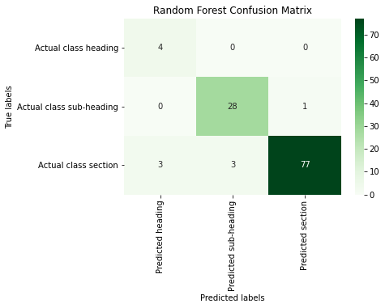
Results
For .docx, .doc files
Final Model used- Random Forest Classifier
Accuracy- 0.939

Slide 11
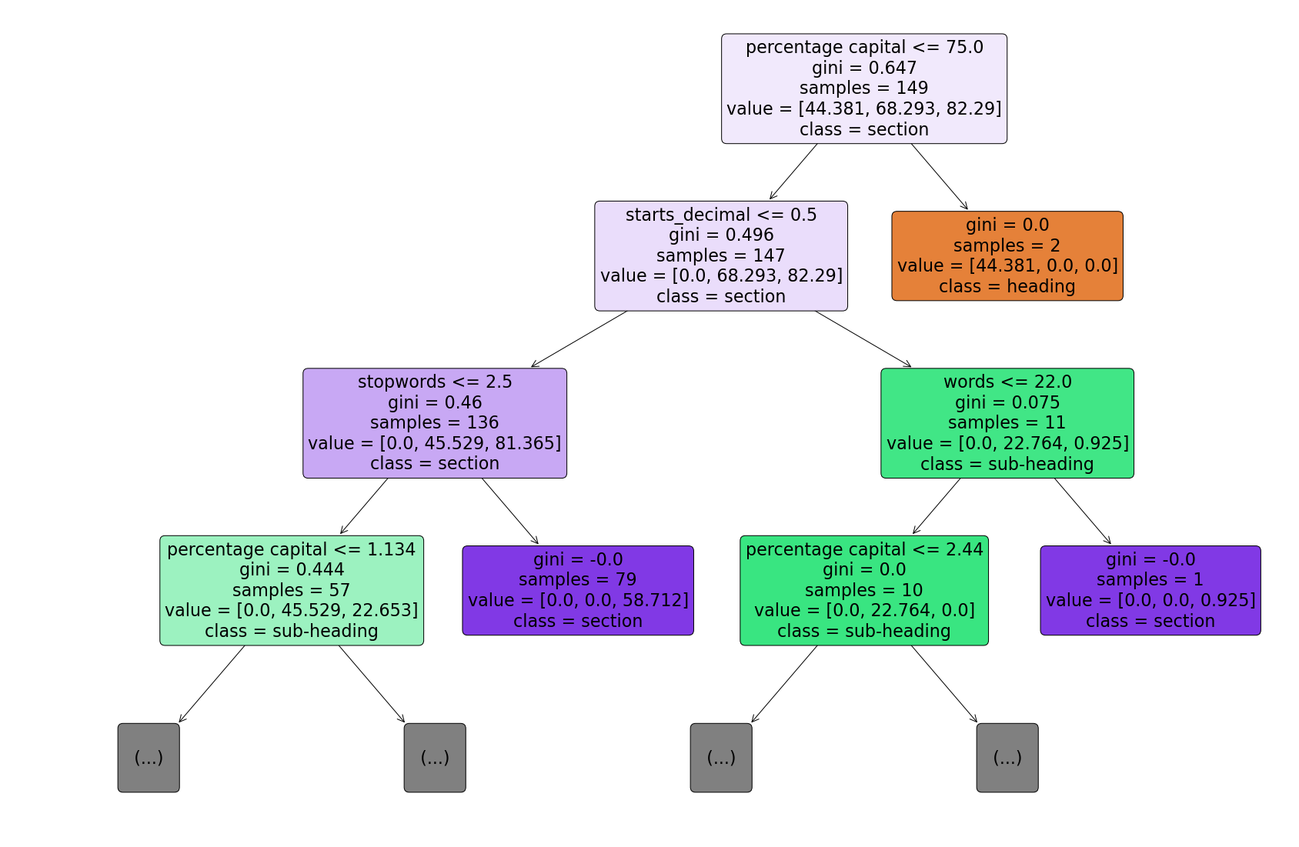
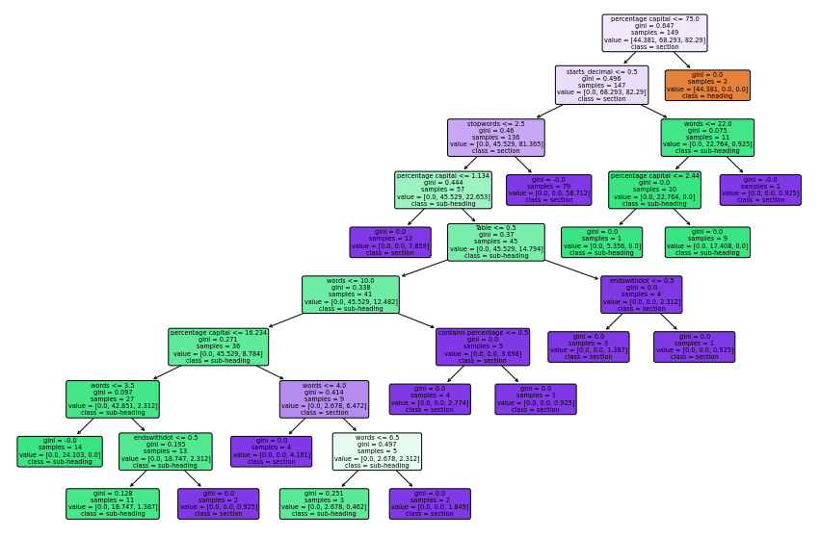
Visualization of Random Forest trees-
One of the decision tree in the Random Forest
Zoomed in version

Slide 12
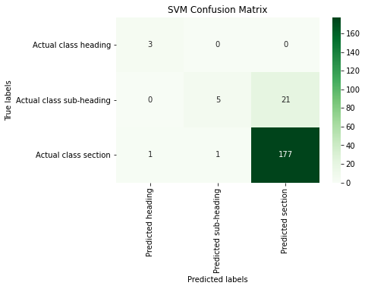
For .txt files
Final Model used- Support Vector Machine Classifier
Accuracy- 0.889

Slide 13
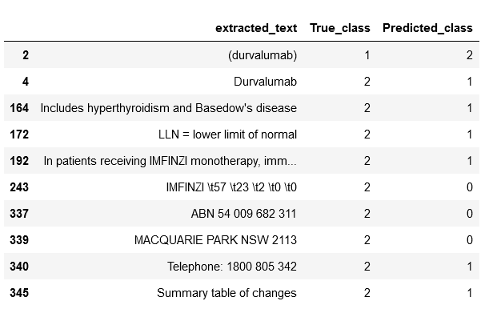
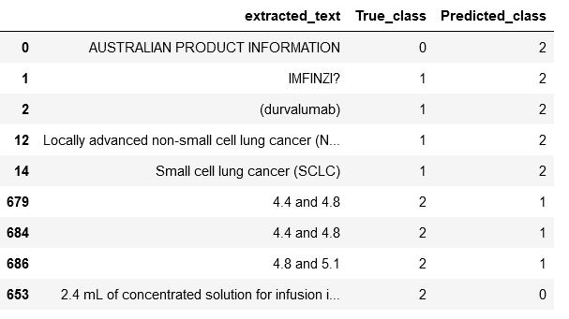
Misclassified samples-
For .docx, .doc files
For .txt files

Slide 14
Table of Contents:
Segmentation of Document – Preprocessing Step
Machine Learning Approach
Features
Exploratory Data Analysis
Results
Evaluation Metrics
Document Reconstruction
References

Slide 15
Document Reconstruction
Segment
Services
Headings
Blocks which were predicted as headings were concatenated with heading tags at beginning and end of strings.
Formatting was tried to be preserved as much as possible
Sub-headings
Blocks which were predicted as sub-headings were concatenated with sub-heading tags at beginning and end of strings.
Considerations for presence of hyperlinks was taken into account. Formatting was tried to be preserved as much as possible
Section
Blocks which were predicted as sections contiguously were combined as single sections.
Considerations were taken while dealing with tables, images and hyperlinks so that formatting was retained as much as possible.

Slide 16
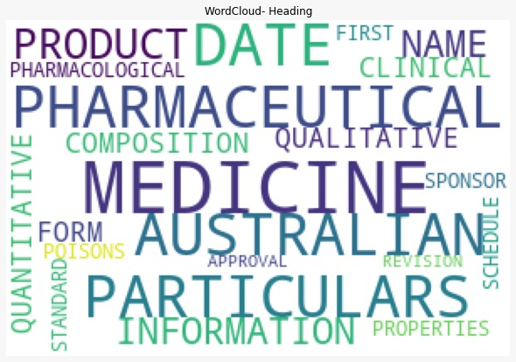
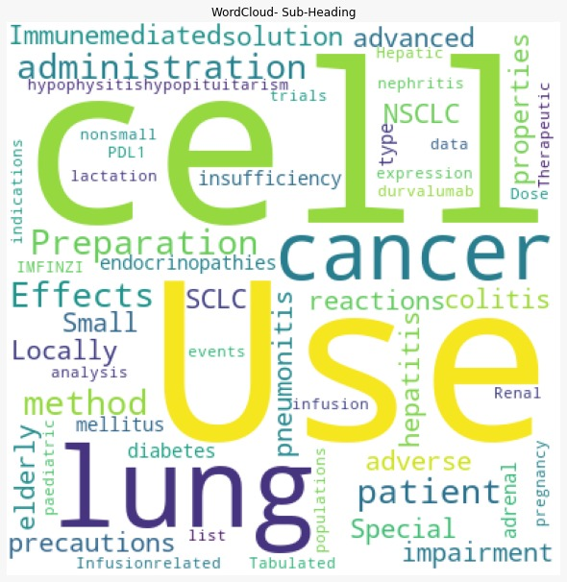
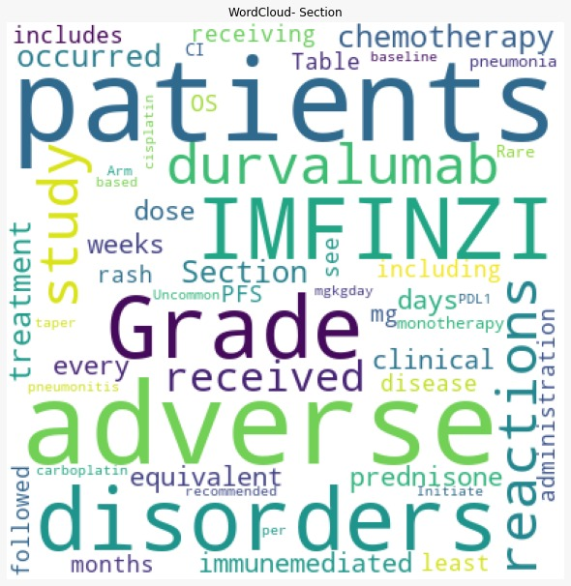
Further Improvements
Tf-idf : specific to type of document used. Would be valuable when a specific type of document is of interest. Eg: Scientific journals, fiction type document. Can be used in further improvements of classifier model.
A hybrid approach combining both tf-idf and non tf-idf features can also help in improving the results and increase robustness of the model.
Notes:
Supporting Slide 1

Slide 17
distilBERT – Hugging Face
Hugging Face Model
Last layer changed and fine-tuned
Drugs.com dataset
25K Headings
48K Sub-Headings
2L Section type classes
Taken from various drugs related dataset to accurately depict the problem in hand
Web scraping done using Beautiful Soup

Slide 18
MODEL PERFORMANCE
F1 SCORE FOR HEADINGS
F1 SCORE FOR SUBHEADINGS
0.81
0.90
F1 SCORE FOR SECTION
ACCURACY
O.95
0.89

Slide 19
References
1. S. Vanderbeck, J. Bockhorst, C. Oldfather; “A Machine Learning Approach to Identifying Sections in Legal Briefs”, MAICS 2011
2. Python – docx documentation
Team Krushers:
Rajas Takle
Pudhuyugan
Kumaran
Vignesh Kumar

